Slide 1
Web Development for a Restaurant Management System
NAME: AFIYA SAINU T S
RRN: 220071601016
CLASS: BTECH CSE- A
YEAR: 3RD YR

Slide 2
ABSTRACT
The Restaurant Management System is a comprehensive web-based platform developed using the MERN stack (MongoDB, Express.js, React.js, Node.js) along with HTML, CSS, and JavaScript for a dynamic and user-friendly interface. It streamlines essential restaurant functions, allowing users to explore an interactive digital menu, make real-time table reservations, provide feedback, and access contact information. The backend, powered by Node.js and Express.js, ensures efficient data handling, while MongoDB offers a scalable database solution. React.js forms the responsive frontend, ensuring a seamless experience across devices. This system optimizes restaurant operations and enhances customer engagement through the integration of modern web technologies.

Slide 3
REQUIREMENTS
Frontend: React.js, HTML5, CSS3, JavaScript; Responsive design for 4 screen sizes.
Backend: Node.js, Express.js.
Database: MongoDB (1 instance, 4 collections: Menu, Reservations, Feedback, Users).
Hosting: 1 web server (AWS/Heroku), 1 cloud database (MongoDB Atlas).
User Authentication: 2 roles (Admin, Customer), JWT/session-based authentication.
APIs: 5 RESTful APIs (Menu, Reservations, Feedback, User Management, Contact).
Testing: 3-5 unit tests, 2 end-to-end tests.
Performance: Load testing for 1000+ users, <2 sec response time.
Security: SSL encryption, 100% input sanitization.
Integration: Payment gateway (future), Email service (SMTP/SendGrid).

Slide 4
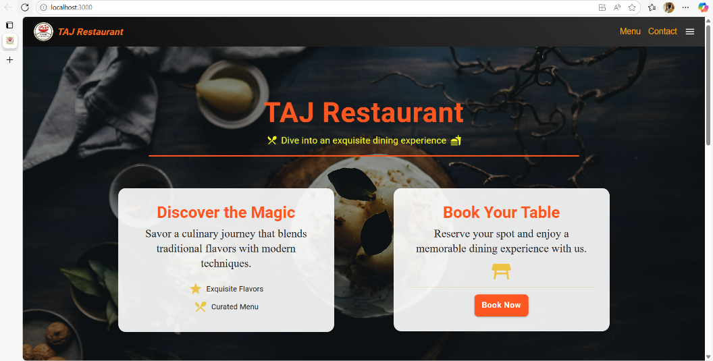
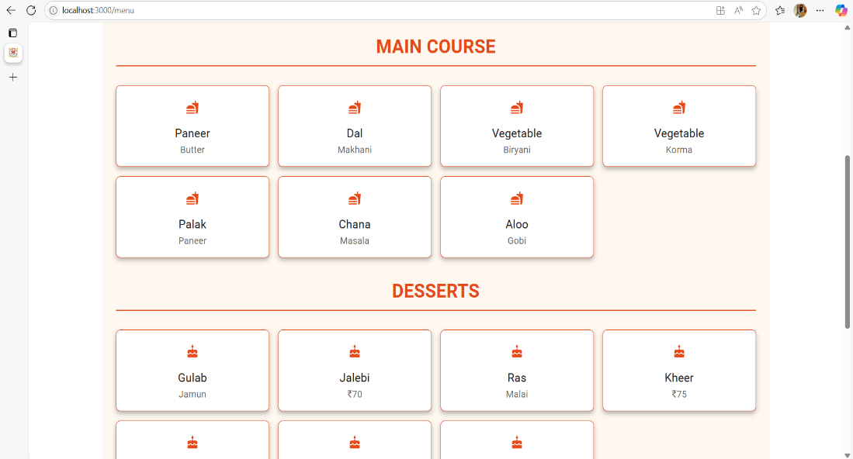
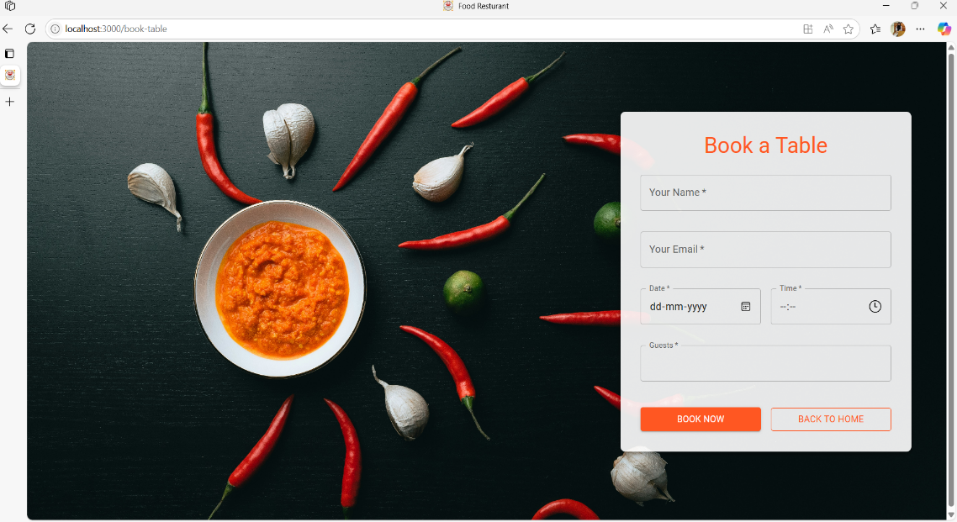
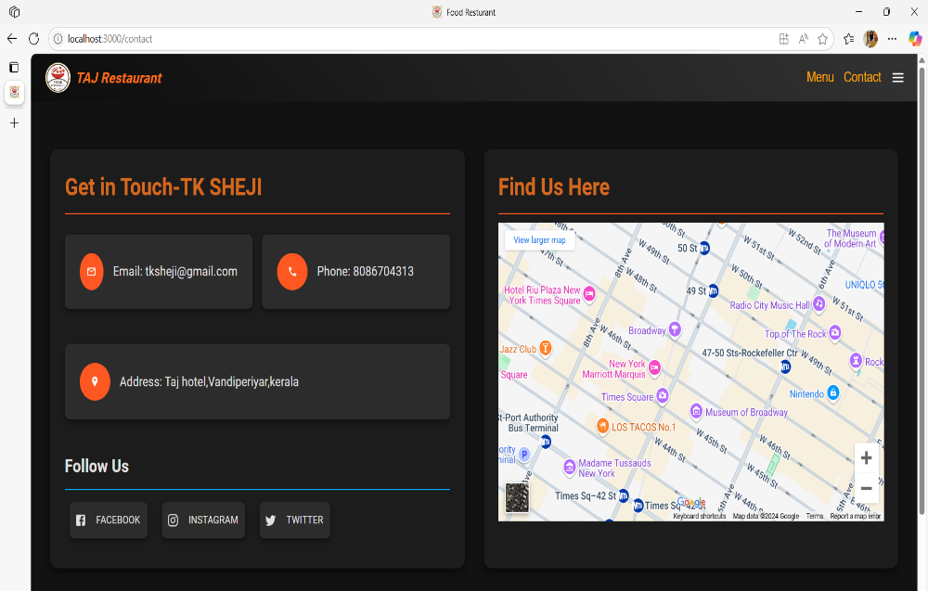
WORKING MODEL

Slide 5
CONCLUSION
The RMS project integrates modern web technologies (React.js, Node.js, Express.js, MongoDB) and cloud platforms to address challenges in the restaurant industry. It offers scalable solutions for menu management, reservations, and customer feedback, providing a user-friendly interface for customers and an intuitive backend for admins. The system ensures smooth communication between the frontend (port 3000) and backend (port 5000), with MongoDB Atlas managing dynamic data. Security is enhanced with JWT authentication and role-based access. Deployed on Heroku, it supports automatic scaling for varying traffic. The RMS is adaptable for future enhancements like AI-driven recommendations and loyalty programs.

Slide 6
RESULTS AND DISCUSSIONS
The RMS successfully meets all functional requirements:
Menu Management: Easy dish management for admins.
Table Reservations: Efficient, real-time booking system.
Customer Feedback: User reviews and ratings functionality.
Port Usage: Frontend tested on port 3000, backend API on port 5000.
Deployment: Deployed on Heroku with integrated frontend and backend.
Performance:
API response: 300ms average.
Smooth development with efficient port usage.
User Experience: Responsive design for all devices.
Challenges: Minor port conflicts resolved during setup.
Objective Achievement:
Menu Management: Achieved
Table Booking: Achieved
Secure & Scalable Architecture: Achieved

Slide 7
REFERENCES
https://css-tricks.com/
https://docs.npmjs.com/
https://www.djangoproject.com/start/
https://www.python.org/doc/
https://www.freecodecamp.org/

Slide 8
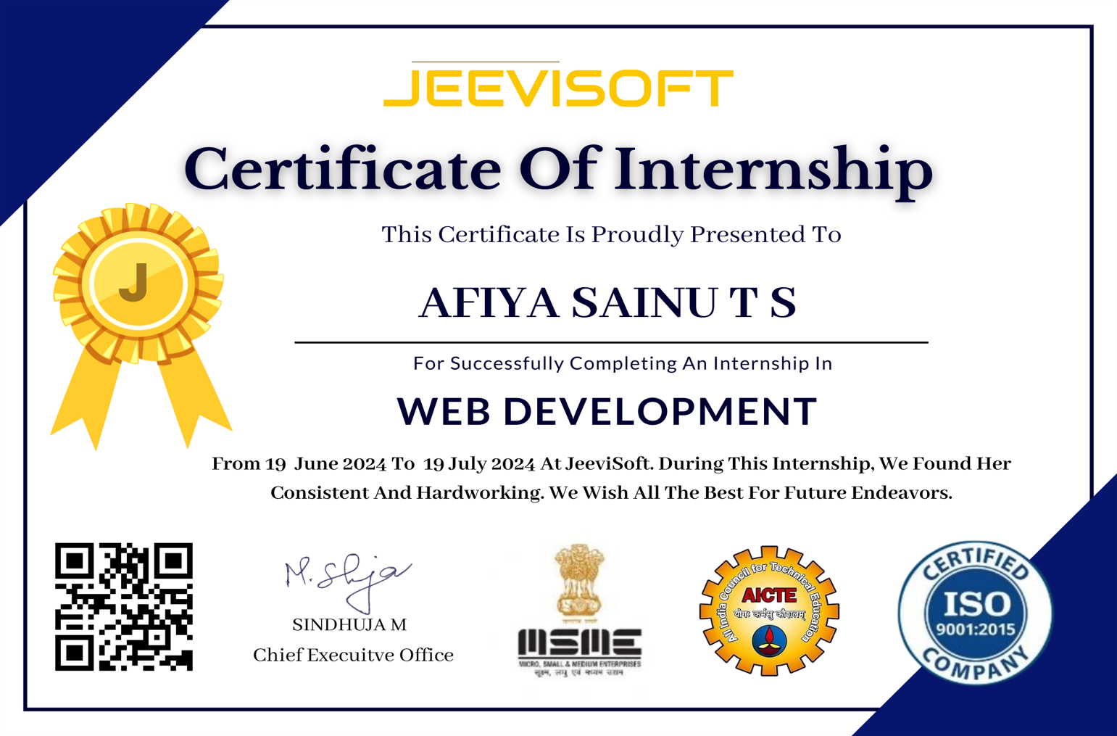
INTERSNSHIP CERTIFICATE

